Slide 2
MINOR PROJECT-1
FINAL PRESENTATION
ON
CryptCom: Secure and Fast Communication using Encryption and Compression Technique
Presented By
Prakash Tiwari R100217049 500062116
Amrit Kumar R100217007 500062268
Akshit Chauhan R100217004 500062444
Gaurav Singh R100217026 500062611
Under the guidance of
Pushpendra Kumar Rajput
Assistant Professor
Department of Cybernetics, SoCSE

Slide 3
Introduction
CryptCom is the abbreviation for Encrypted Communication.
A Chatting Platform using Data encryption and Data Compression techniques in C
Making a platform which is secure so that multiple client can communicate with each other.
We are using compression technique to speed up file transfer.

Slide 4
Problem Statement
To establish a connection between multiple users, enable them to communicate with one another with a decentralized encryption and compression technique, for secure communication.

Slide 5
Objectives
To establish a Connection between 2 or more hosts in a server.
To apply Huffman Code for Data Compression.
To apply RSA Algorithm for Data Encryption.
At the Receiver side: Decompress the message and decrypt for the desired output.

Slide 6
OBJECTIVE ACHIEVED
Socket Connection is achieved.
We have achieved compression using Huffman Encoding/Decoding algorithm.
We have achieved Encryption & Decryption of message using RSA
Now we have achieved our main objective by integrating above objectives to form secure and fast chatting platform.

Slide 7
Structure Chart
Msg : Message
Enc : Encrypted
Comp: Compressed
Client
Enc and comp msg
Server
Enc and comp msg
msg
msg
Enc and comp msg
enc msg
enc msg
msg
enc msg
Message
msg
enc msg
Show Message
Compression
De-Compression
Encryption
Decryption

Slide 8
Socket Connectivity
Server side: Server Create socket using socket(AF_INET, SOCK_STREAM, 0).
Bind socket to a specific port where clients can contact the server .
listen(int sockfd, int backlog); It puts the server socket in a passive mode, where it waits for the client to approach the server to make a connection.
Client side: Create socket using socket (AF_INET, SOCK_STREAM, 0).
Client connect to the server using connect () method in local host ip.
Client and server can send the message.
Type exit to terminate the chat

Slide 9
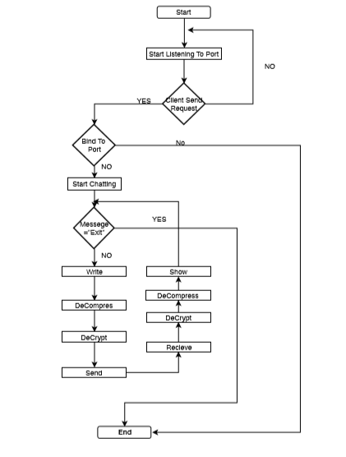
Flow Chart

Slide 10

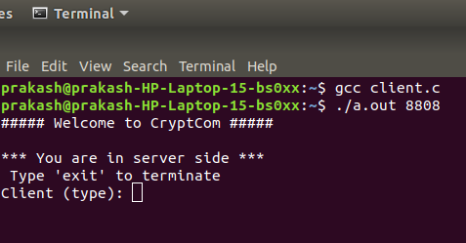
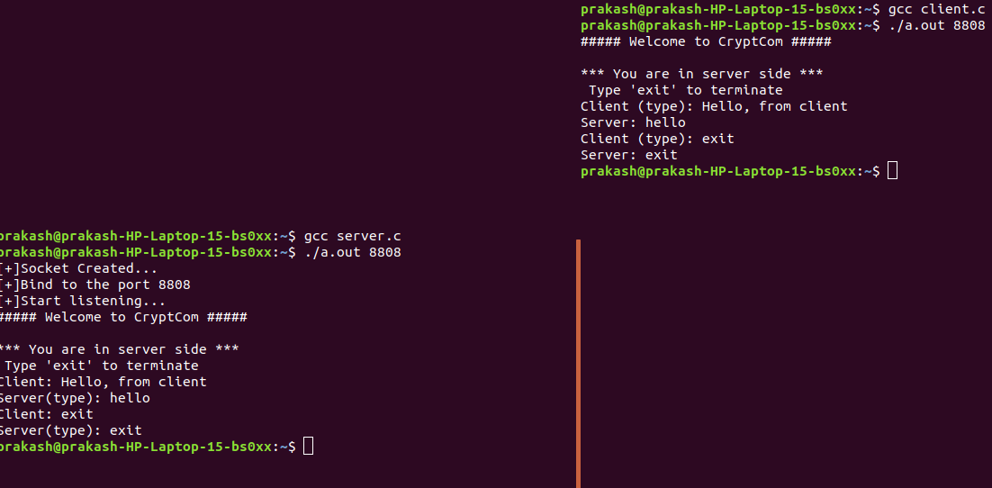
OUTPUT

Slide 11
Huffman Algorithm
Input: Number of message with frequency count.
Output: Huffman merge tree.
Create a leaf node for each unique character and build a min heap of all leaf nodes .
Extract two nodes with the minimum frequency from the min heap.
Create a new internal node with a frequency equal to the sum of the two nodes frequencies.
Repeat steps#4 and #5 until the heap contains only one node. The remaining node is the root node and the tree is complete.

Slide 12
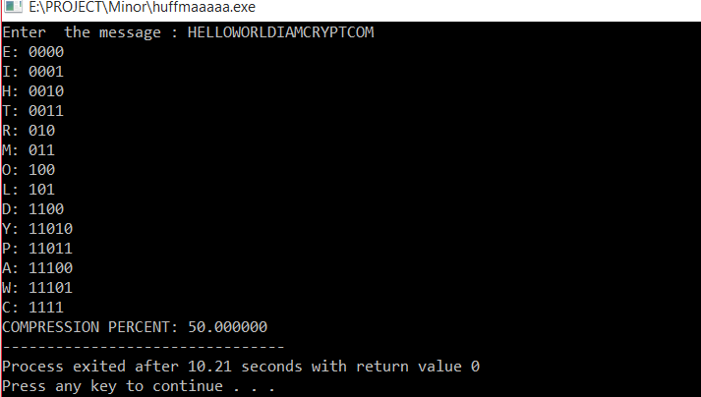
OUTPUT

Slide 13
RSA Algorithm
Choose two large prime no: p and q
Calculate n: n = p*q
Calculate Euler's totient function q(x): q(x) = (p-1)*(q-1)
Choose an integer e, 1 < e < q(x) such that gcd(e,q(x)) = 1
Calculate d, 1 < d <q(x) such that: d.e = 1 mod q(x)
Public key is (n, e)
Private key is (n, d)
Encryption: The Cyphertext C is found by the equation C = M^e mod n
(where M is the original message)
9. Decryption: The message M can be found from the cyphertext C by the
equation M = C^d mod n

Slide 14
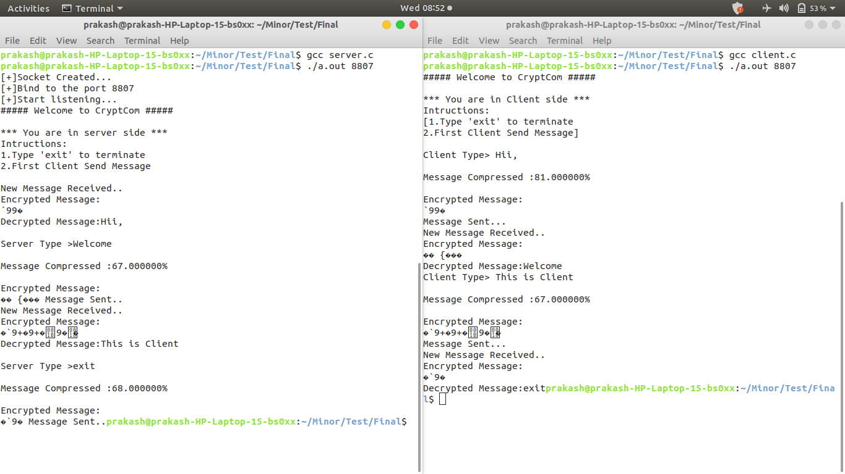
Final Output

Slide 15
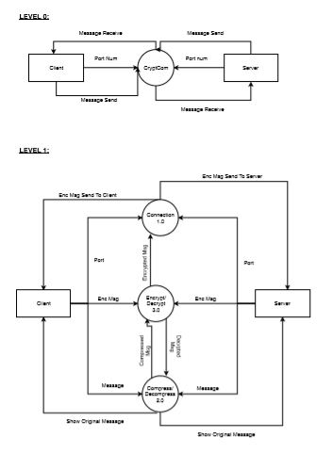
Data Flow Diagram

Slide 16
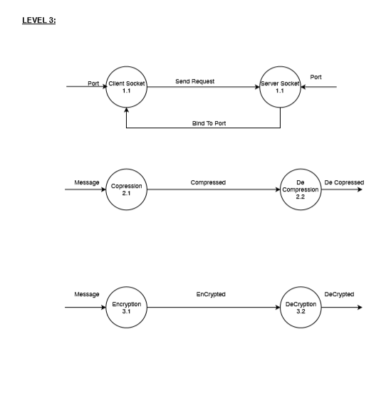
Data Flow Diagram(contd.)

Slide 17
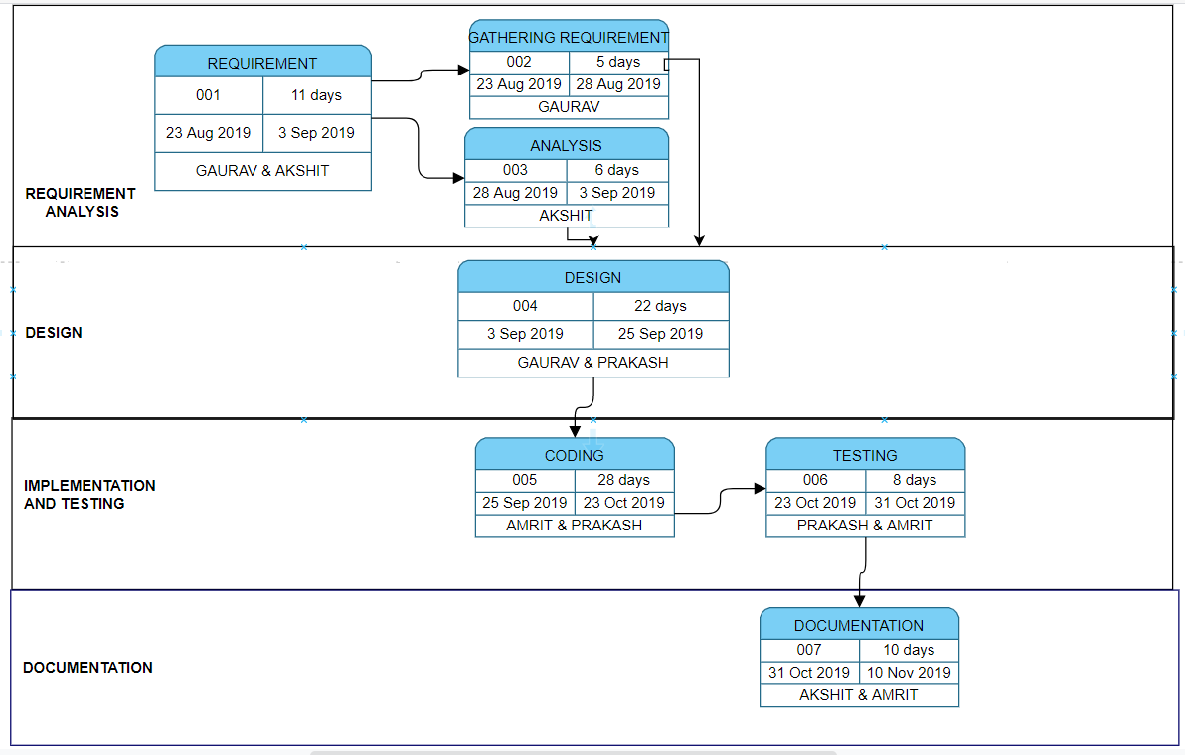
Pert Chart

Slide 18
Reference
1) http://www.networksorcery.com/enp/data/encryption.htm
2) https://en.wikipedia.org/wiki/Huffman_coding
3) https://www.geeksforgeeks.org/socket-programming-cc/
4) https://www.gatevidyalay.com/huffman-coding-huffman-encoding/
5) M.Prettha,M.Nithya “A study and performance analysis of RSA Algorithm” http://www.ijcsmc.com/
6)https://www.youtube.com/watch?v=_lQ3S4fJ0U&list=PLPyaR5G9aNDvs6TtdpLcVO43_jvxp4emI

